Slide 1
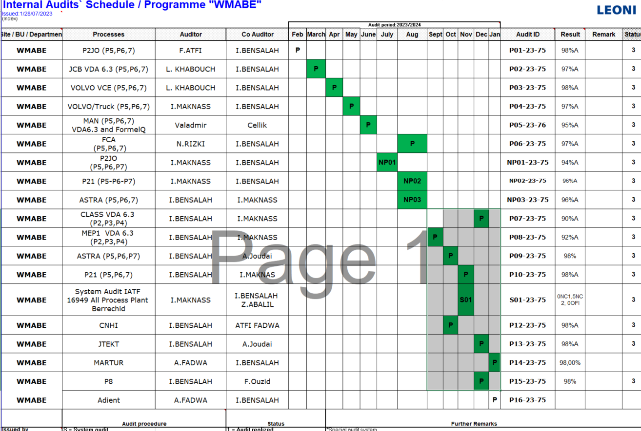
Planification
Outputs
Liste Status de la planification
Retard+Next Audits

Slide 2
